Slide 1
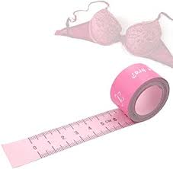
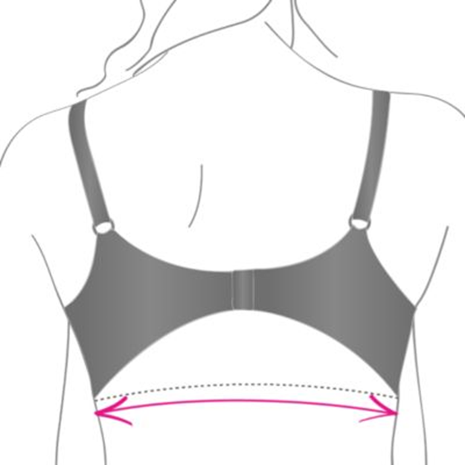
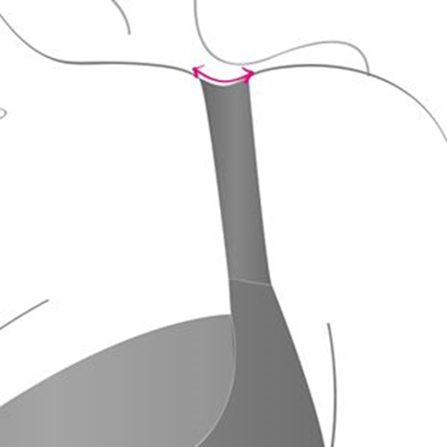
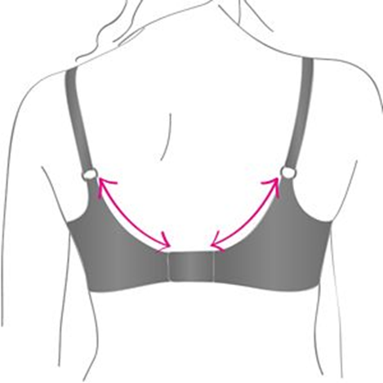
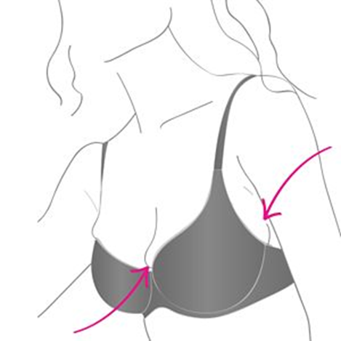
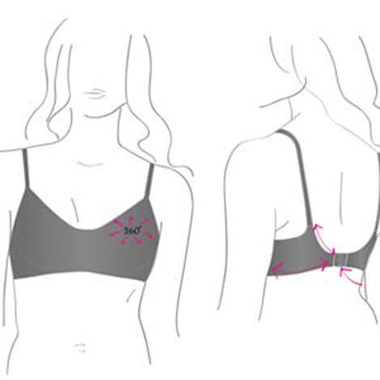
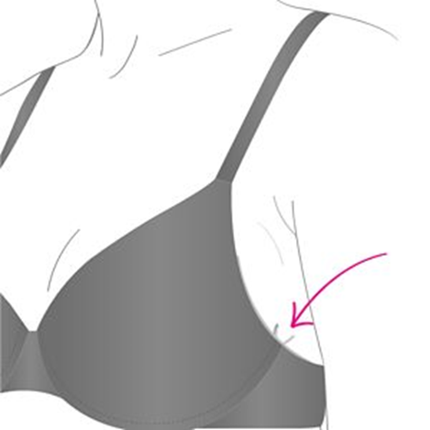
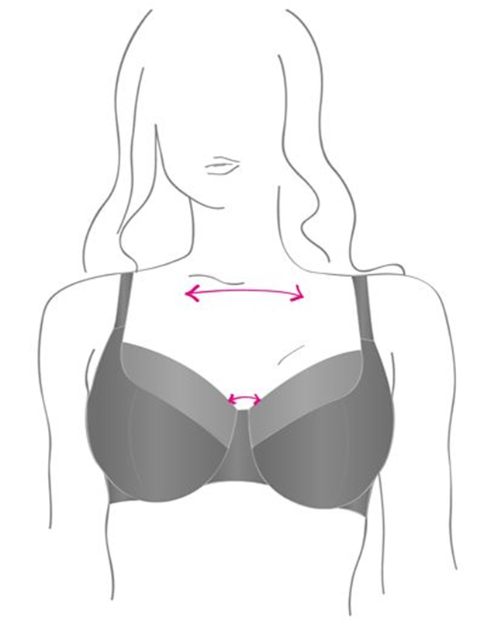
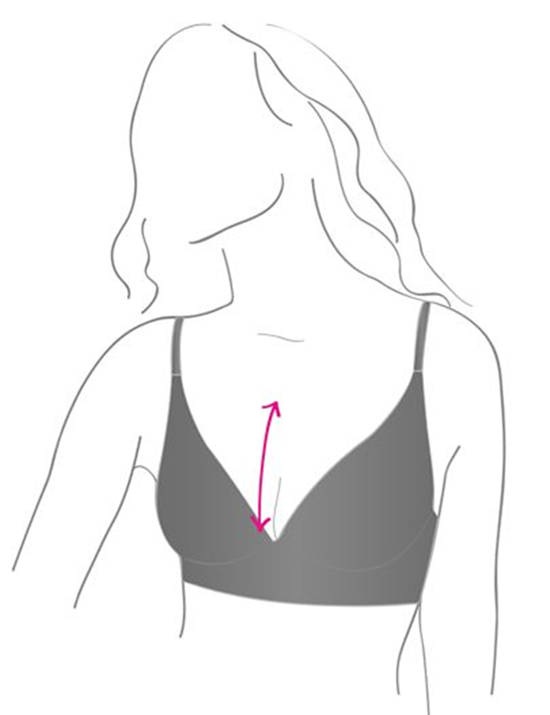
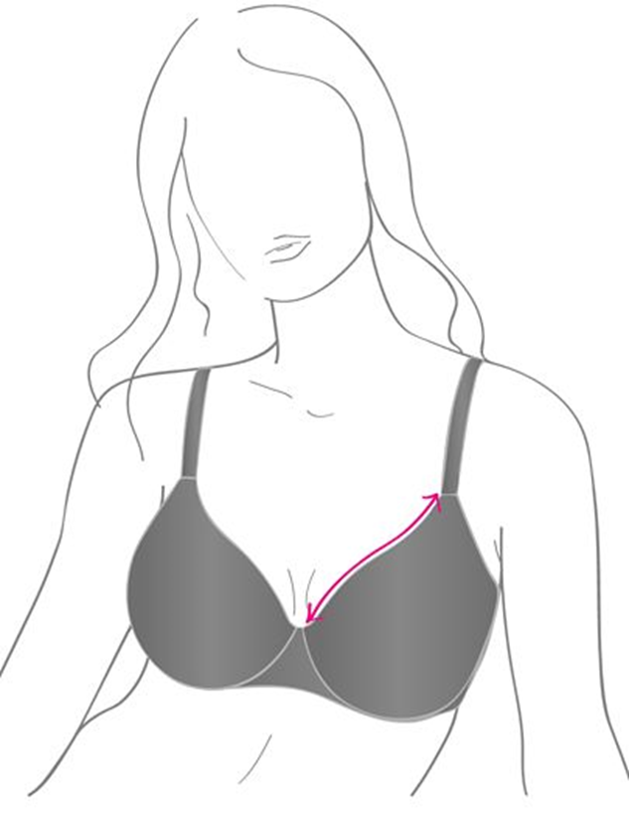
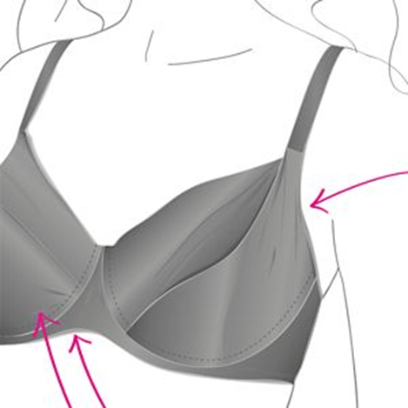
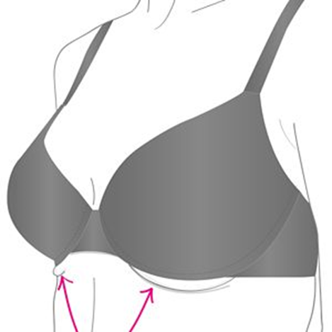
Bra Guide
Size + Shape = Perfect Bra Selection

Slide 2
Problem Mapping
Bra Fit Problem
Bra Size
Best Suitable Bra

Slide 3
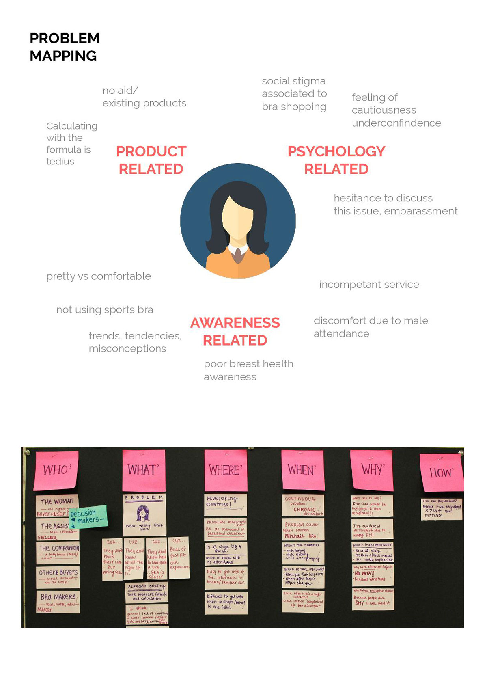

Slide 4
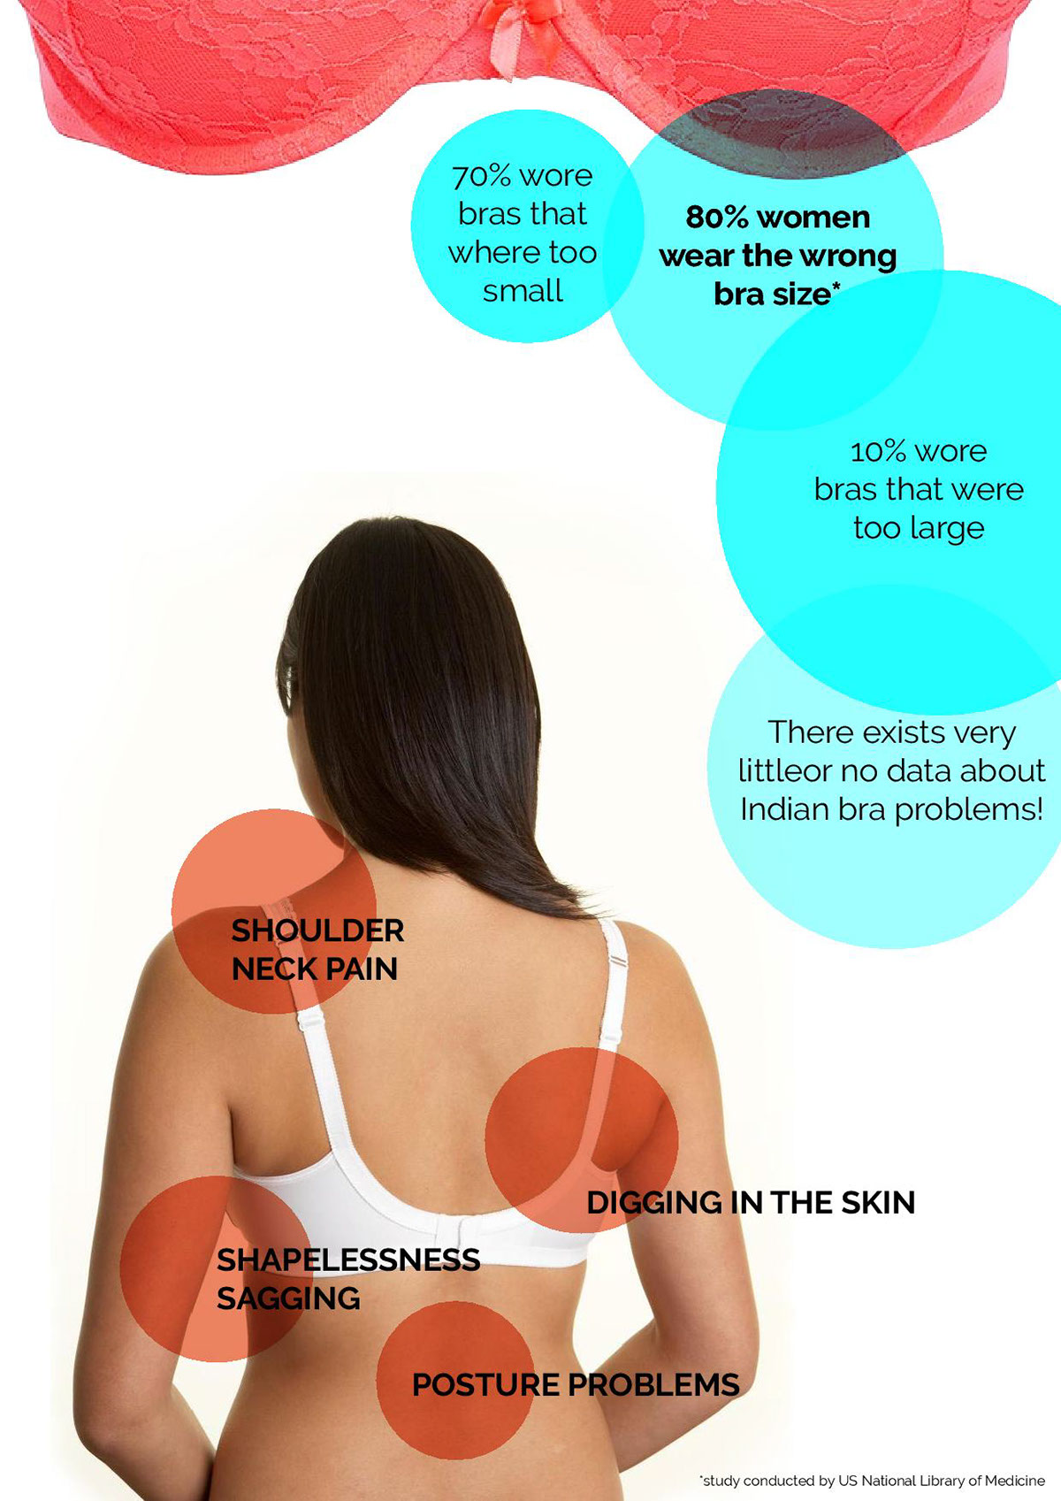

Slide 5
1.Breast Pain
One of the first things you may notice from wearing the wrong size bra is breast pain. Complaints are more typical of people with larger breast cup sizes, who exercise infrequently, or who are premenopausal.
There are many ways in which the wrong size bra can contribute to breast pain. If your bra is too small, it can dig into your breasts — if it is too big, your breasts may have too much room and can become prone to bouncing around, contributing to tenderness. Lastly, if you suffer from breast asymmetry or other abnormalities, it may feel like every bra is the wrong size. For this reason, you may consider congenital breast asymmetry surgery or breast augmentation.
Of course, there can be other causes of breast pain, including pregnancy, breastfeeding, menstruation, and exercise — so make sure to rule out other causes before determining that the pain is from your bra.

Slide 6
2.Back Pain
While research on the correlation between ill-fitting bras and back pain is often inconclusive or conflicting, there are some studies suggesting a link. Moreover, a large percentage of women wear the wrong size bra, especially women with larger breasts. Research is clear that bigger breasts cause back pain — or at the very least, exacerbates existing pain.
Improper breast support may directly or indirectly contribute to back pain. Either way, try to prioritize finding the right size bra. The volume of your bra cup should correspond with the volume of your breasts. Ensure your bra fits correctly by having a professional fit you for it. A well-fitted bra may be a good option if back pain is persistent.

Slide 7
3.Shoulder and Neck Pain
Women with larger breasts may also experience shoulder and neck pain. Bras designed for larger breasts often come with larger straps in order to disperse weight and provide more support. These wide straps, however, can cause shoulder pain which can then contribute to neck pain as well.
Sometimes even a properly fitted bra can’t fix shoulder and neck pain though — or other pains for that matter. If you’ve been fitted for a bra, but still experience these symptoms, it may be time to talk to your doctor.
Research shows that breast reduction improves symptoms of macromastia. You may be a good candidate for breast reduction surgery if you are at a healthy weight, but are otherwise experiencing adverse symptoms such as shoulder and neck pain, back pain, or breast pain.

Slide 8
4.Skin Abrasions and Chafing
A bra that is too tight can easily cause skin abrasions and chafing from the constant rubbing against your skin. You may see red lines anywhere the bra falls, including your overbust, underbust, back, or shoulders.
Besides correcting your bra size, you may also find that using a strap extender or finding a different bra material or texture helps. For sports bras, chafing may be widespread and require you to find a different style bra.

Slide 9
5.Rib Cage Pain
Bras sit right on top of your rib cage. When you’re wearing one that is too tight, it can feel constricting and may even contribute to pain. You are also likely to see skin abrasions and chafing.
Underwire bras are typically the number one culprit for pain associated with the rib cage. While no research seems to suggest that this will cause any actual damage to the area, if you’re experiencing discomfort it may be worth it to look into other styles of bras.

Slide 10
6.Premature Sagging
Bras are designed to lift up your breasts and provide support, but if you’re wearing the incorrect size, they may do exactly the opposite. One that is too big, for instance, may leave too much room for your breasts instead of providing the support they need.
Avoid premature sagging by getting professionally fitted for a bra.

Slide 11
7.Bad Posture
Several of the pains mentioned — breast, back, shoulder, and neck pain — may result in bad posture. The pain can make a person hunch forward in an effort to alleviate it. Bad posture may actually exacerbate back, shoulder, or neck pain, creating a vicious cycle.

Slide 12
8.General Discomfort and Embarrassment
Last but not least, an ill-fitted bra might simply make you feel uncomfortable and embarrassed. Your breasts could end up spilling out of your bra, causing your clothing to fit awkwardly. Bra straps may be digging into your skin contributing to pain or sliding off your shoulders, prompting you to constantly pull them back up.
Mothers may be particularly concerned about the general discomfort and embarrassment of an ill-fitted bra. While it takes time to heal after giving birth, some changes to the body are more permanent.

Slide 13
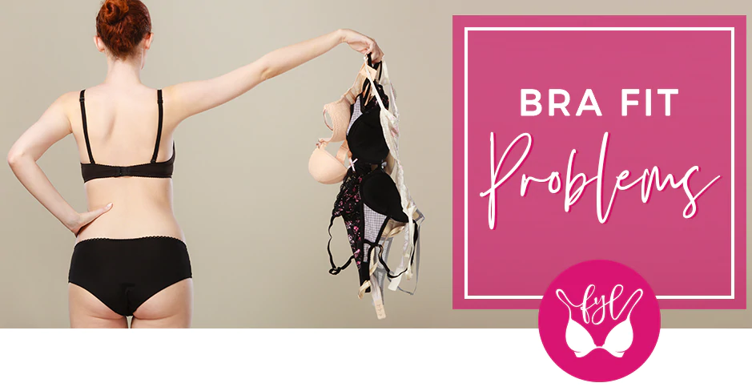

Slide 14
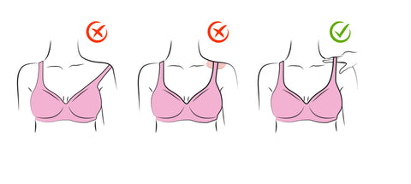
1. Slipping Straps
You are wearing the wrong size if your bra straps keep slipping off your shoulders, or are so tight they are digging into your skin. Straps of the correct sized bra will sit comfortably on your shoulders without slipping off.
Here are a few steps we recommend you to check:
If the straps start to slip off, then try a sister size with a smaller band or fasten the straps tighter.
If the straps are too tight and start to dig into your skin, then you may need to try a bigger band size or loosen the straps.
If you’re able to slide 2 fingers easily under the straps, you’re wearing the right size

Slide 15
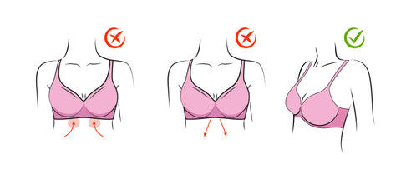
2. Uncomfortable Underwire
The underwire is sewn into the cups of a bra and is designed to provide support to your bust. It should sit comfortably under and to the sides of your bust.
Here are a few steps we recommend you to check:
If the underwire feels too tight, is digging into your skin or restricting your movement, then you should go up a band size.
If you feel that underwire is too loose or ‘floating’ then you should go for a smaller band size.
If the underwire is sitting comfortable under your bust, then you’re wearing the right size.

Slide 16
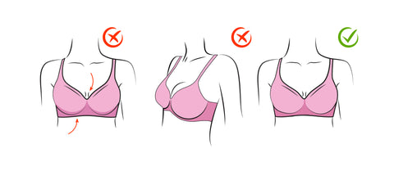
3. Cup Contact
The cups of the bra hold and support your bust. They may or may not have an underwire sewn into them always, so you can pick them basis your requirement. Cups on a well fitted bra will cover and contain all your bust tissues without feeling cramped.
Here are a few steps we recommend you to check:
If there’s space between your bust tissue and the cup, it’s too big for you and you should go down a cup size.
If you find that your bust is spilling over the top or sides of the cups, then you should go up a cup size.
If the cups and underwire sit well on your body, then it’s the right size for you.

Slide 17
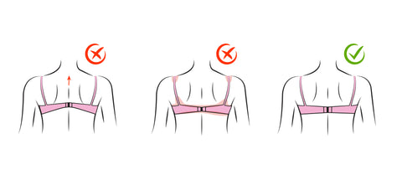
4. Bad Bands
The band helps keep the bra in place and supports your bust in the cup. A well-fitting band will sit straight along your back parallel to the ground.
Here are a few steps we recommend you to check:
If the band rides up along your back, it’s too big and you need to go for a smaller size.
If the band feels too tight or is pinching the skin, then you should go up a band size.
If the band sits straight and is comfortable, you’re wearing the right size.

Slide 18
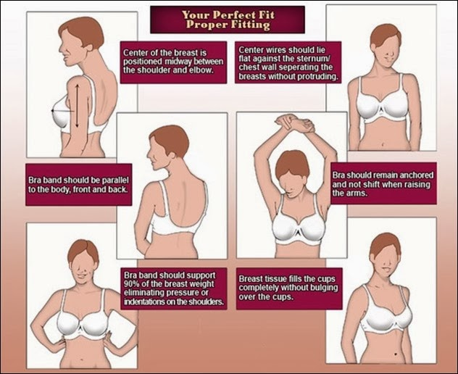

Slide 20
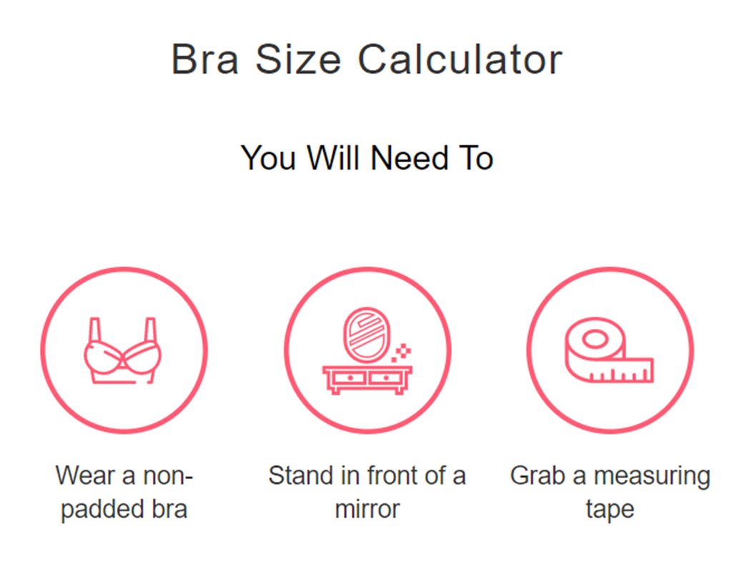

Slide 21
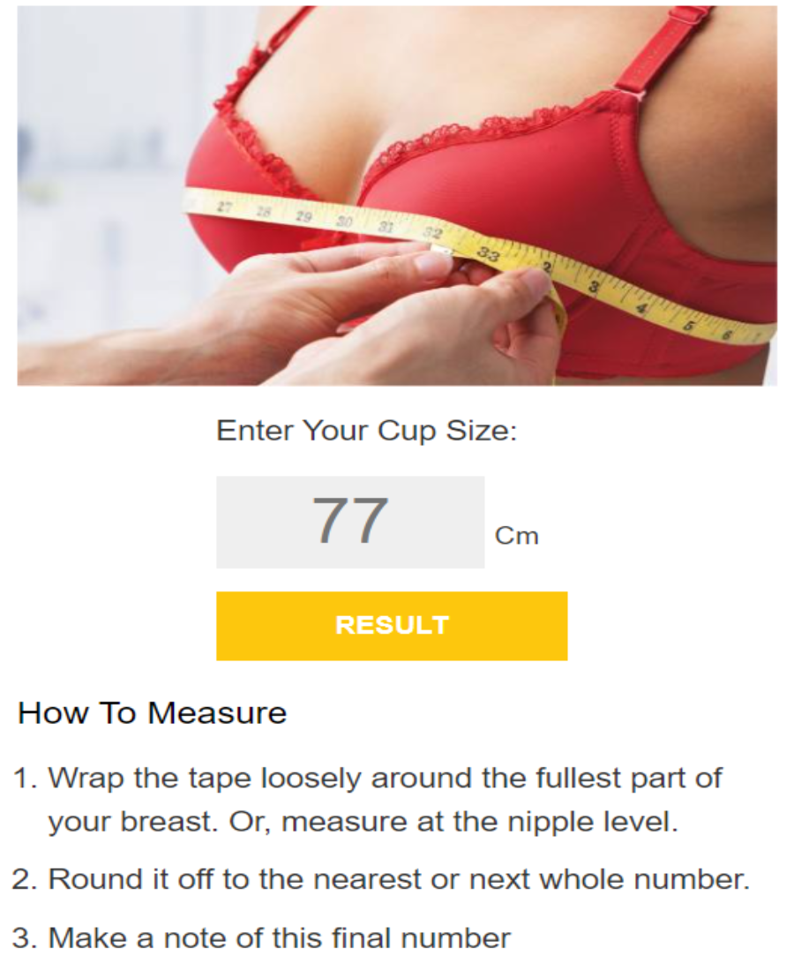

Slide 22
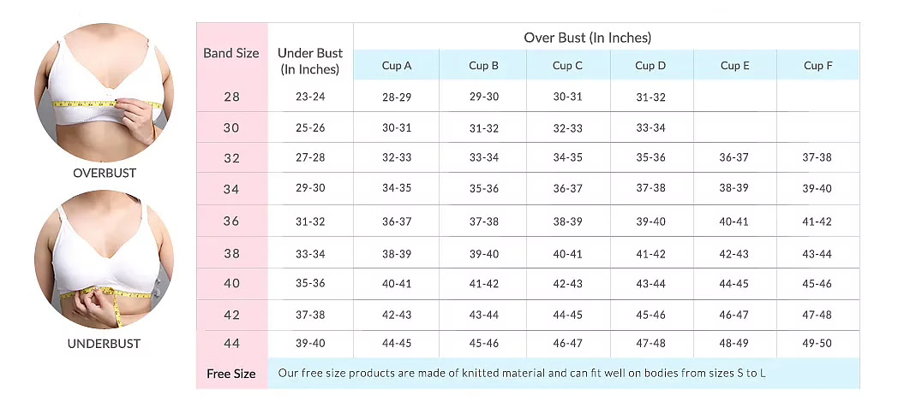
How to measure your size?
British Sizes

Slide 23
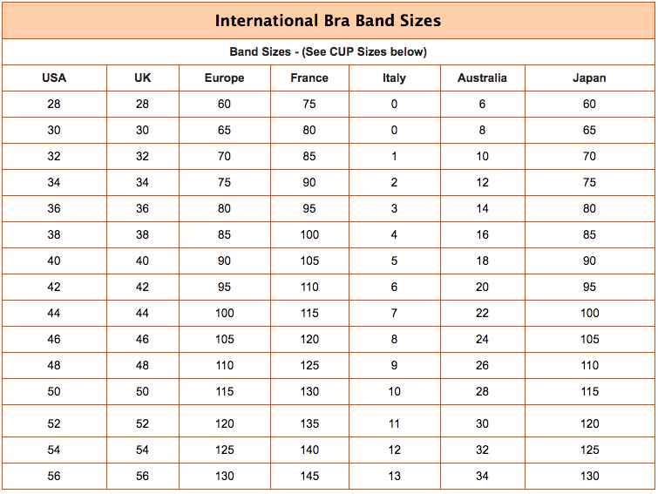

Slide 24
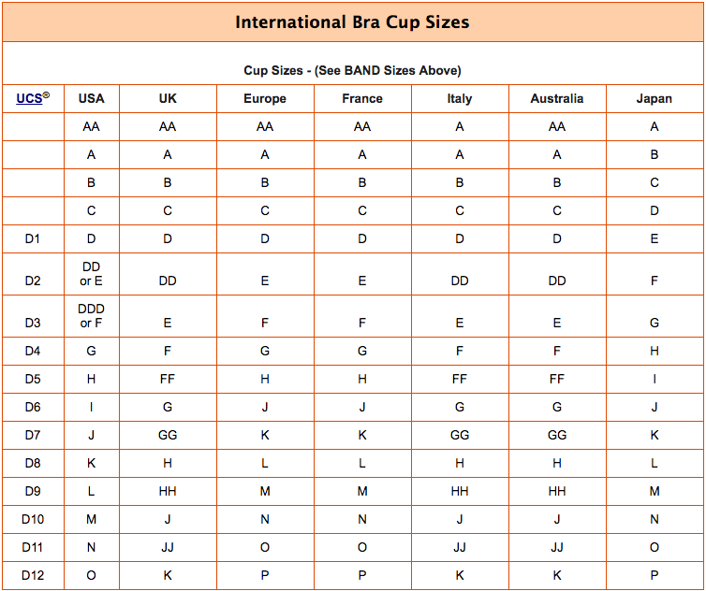

Slide 25
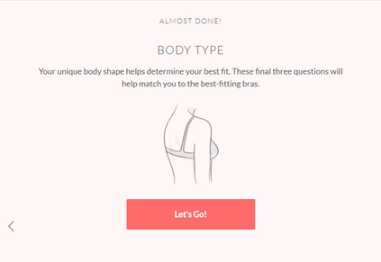
Body Type
Your unique body shape helps your best fit.

Slide 26
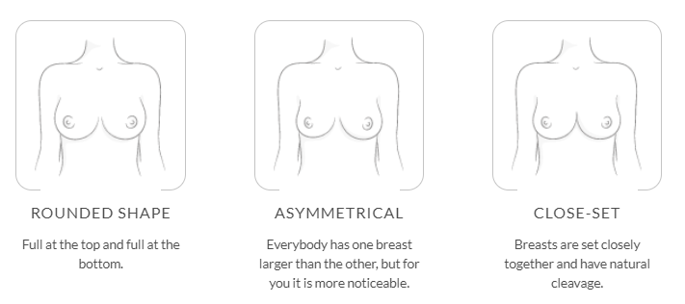
Body Type
Your unique body shape helps your best fit.

Slide 27
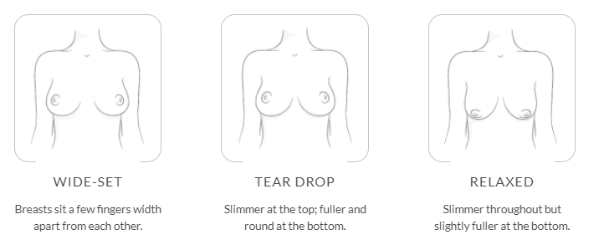
Body Type
Your unique body shape helps your best fit.

Slide 28
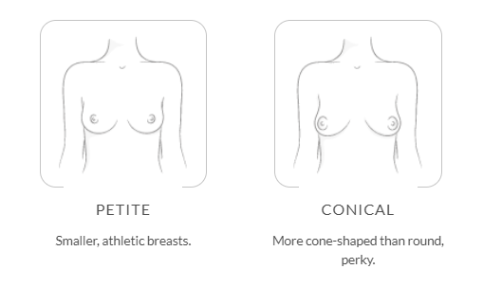
Body Type
Your unique body shape helps your best fit.

Slide 29
Your body shape is important when choosing a bra shape.
Balcony Bra
If you have broad shoulders and a gap between your boobs we've got you covered - balcony is the best style for you.

Slide 30
Your body shape is important when choosing a bra shape.
Plunge Bra
If you have a narrow frame and close cleavage our experts advise you to wear a plunge bra.

Slide 31
Your body shape is important when choosing a bra shape.
Full Cup Bra
This bra suits all body types, our most versatile bra shape.

Slide 32
